Slide 1

CSE523
MACHINE LEARNING PROJECT
PREDICTED BEST XI
Group: Code in Flux
Manasvi Dobariya - AU1841053
Aisha Nagrecha - AU1841137
Dishita Madani - AU1841112
Dhruv Shah - AU1841030

Slide 2


INTRODUCTION
Cricket is one of the most popular sport in the world. The T20 format is one of the most played format in cricket.
The craze of the game has risen so greatly that it has provided a platform for different fantasy leagues. Platforms like Dream11 have risen greatly due to the same.
In fantasy leagues, generally, we are expected to form a team of 11 players from the 22 playing team members of both the teams. The team should be made in such a way that the selected players would perform very well in that match.

Slide 3



PROBLEM STATEMENT
Cricket is a highly competitive and very uncertain game due to the player’s form, venue, opposition, number of innings played.
Every player’s performance can impact the team performance and hence its very important to rate and predict individual player’s performance.
Fantasy cricket bridges the gap between players and the viewers, where viewers could make their own team and make money out of it.
We aim at a predicting best XI from both the playing XI's considering various factors under consideration.

Slide 4
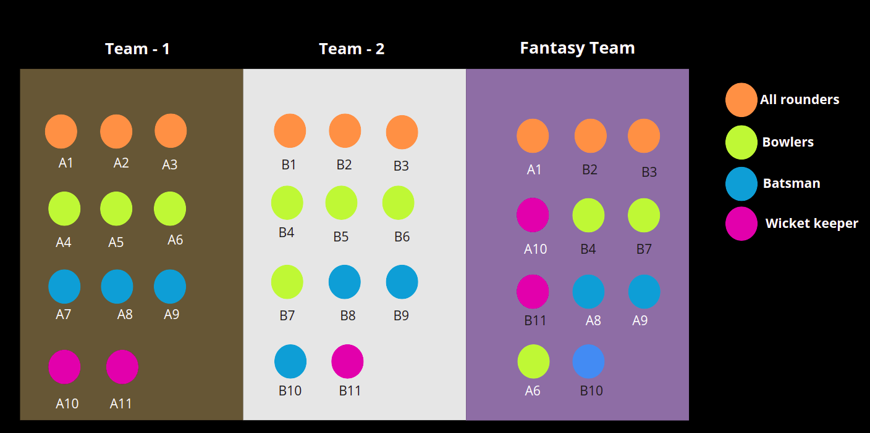
PROBLEM STATEMENT

Slide 5
EXISTING BODY OF WORK
Work in this related problem scenario began with predicting the success of Indian Cricket Team against the frequently played counter-parts using back propagation and radial base network.
Next major step was use of regression model to predict the success of the players in ODI considering the role of the player.
Following that use of XG Boost, Stacking, Random Forest classifiers and similar complex algorithms to achieve better predictions were used.
An attempt similar to the problem selected by us was made using Random Forest, XG Boost, and Shapely Additive Explanation.

Slide 6
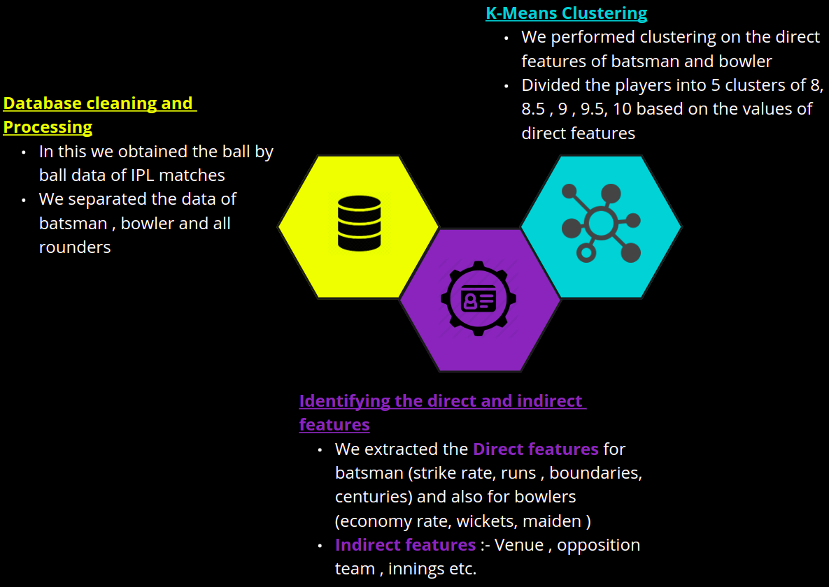
OUR APPROACH

Slide 7
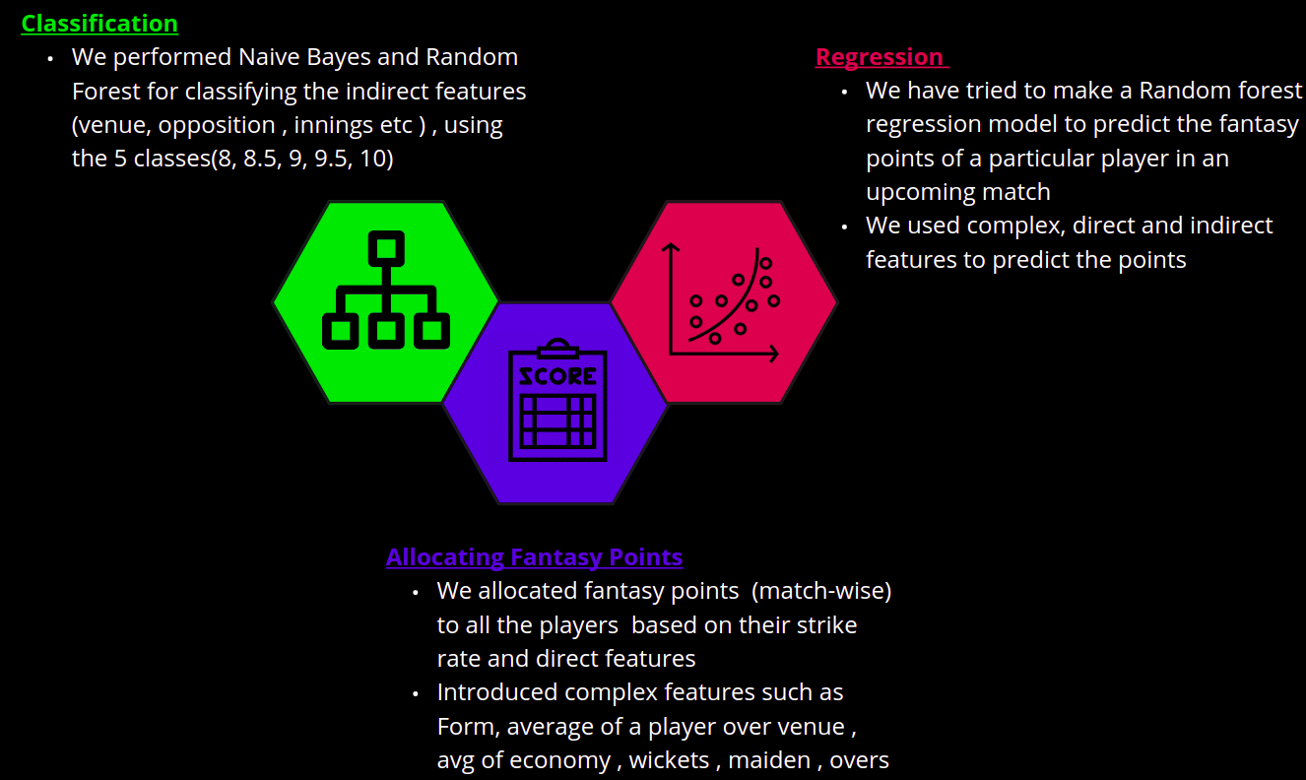
OUR APPROACH

Slide 8
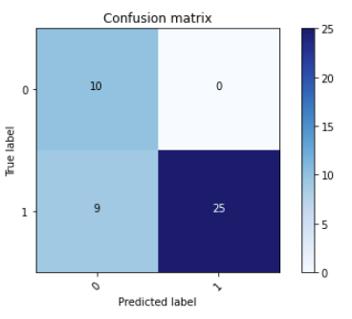
INITIAL RESULTS
First, we implemented Naive Bayes classifier for a binary classifier and obtained the following results:
After that, to improve the prediction, we implemented K-means clustering. In this, the players were divided into 5 classes, point scale being from 8 to 10 with an increment of 0.5.

Slide 9
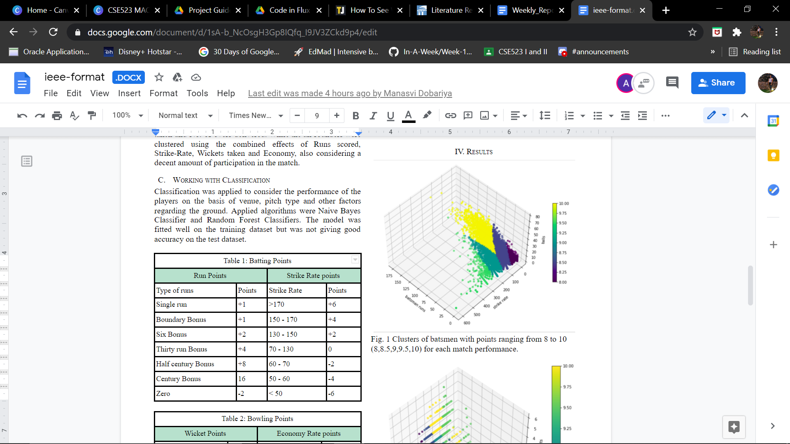
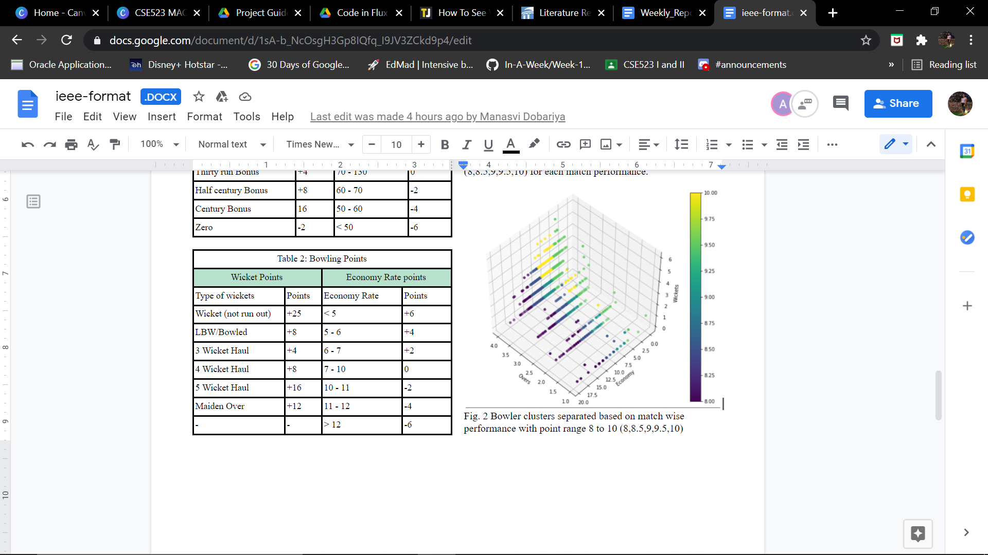
INITIAL RESULTS
Clustering outputs:

Slide 10
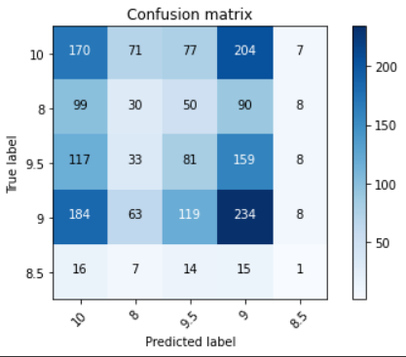
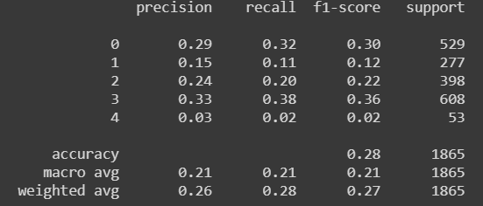
INITIAL RESULTS
Classification outputs:
After clustering, we used Random Forest classifier. Here, we were able to get accuracy of 0.9 for trained data.

Slide 11
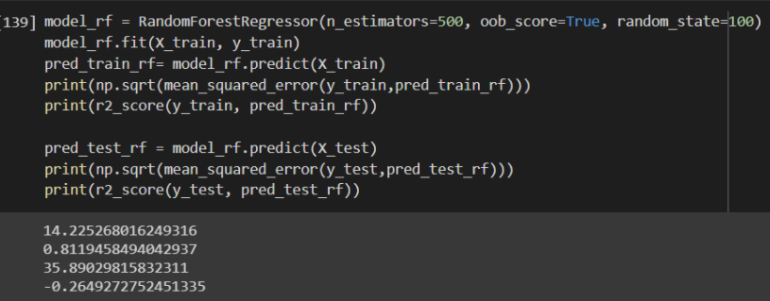
INITIAL RESULTS
Next, we calculated the fanatsy points for all the players
Using these fantasy points, we performed regression using Random Forest regressor where we found the test score and the train score using mean squared error. We were able to get a good score for train data.

Slide 12
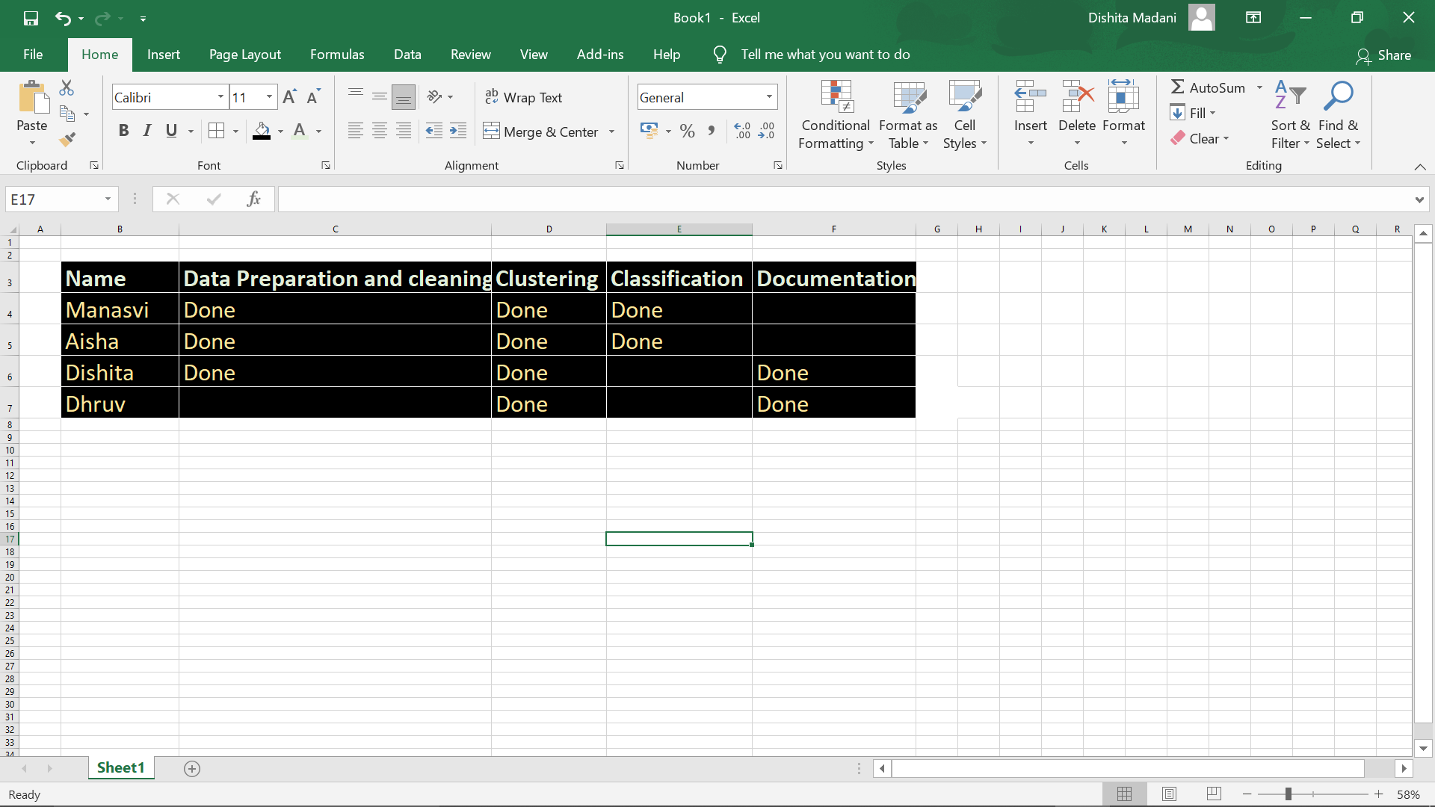
ROLE OF EACH MEMBER

Slide 13
FUTURE WORK
The team would like to overcome the problem of overfitting and find a better accuracy for the model.
We would also consider the factor of recent form of the player as it would play a major role in the success of any team. We aim at achieving it by comparing the ratings given to a particular player for a particular match with his career ratings and process accordingly.
Develop a Regression Model so that the constraints according to Dream11 can be taken into account.

Slide 14
REFERENCES
Nihal Patel and Mrudang Pandya, “IPL Player’s Performance Prediction”, International Journal of Computer Sciences and Engineering, Volume 7, Issue 5, May-2019, E-ISSN 2347-2693, https://www.ijcseonline.org/pdf_paper_view.php?paper_id=4268&
Sonu Kumar and Sneha Roy, “Score Prediction and Player Classification Model in the Game of Cricket using Machine Learning”, International Journal of Scientific & Engineering Research, Volume 9, Issue 8, August-2018, ISSN 2229-5518, https://www.ijser.org/researchpaper/Score-Prediction-and-Player-Classification-Model-in-the-Game-of-Cricket-Using-Machine-Learning.pdf

Slide 15
REFERENCES
Nilesh M. Patil, Bevan H. Sequeira, Neil N. Gonsalves and Abhishek A. Singh, “Cricket Team Prediction Using Machine Learning Techniques”, https://papers.ssrn.com/sol3/papers.cfm?abstract_id=
Kalpdrum Passi and Niravkumar Pandey, “Predicting Players’ Performance in One Day Internation Cricket Matches Using Machine Learning”, https://airccj.org/CSCP/vol8/csit88310.pdf
Madhav Goswami and Abhishek Anand, “Dream11 Team Predictor with Python and Machine Learning”, https://medium.com/analytics-vidhya/dream11-team-predictor-with-python-and-machine-learning-f0dfce1489eb
Dataset: https://www.kaggle.com/laxmena/ipl-dataset-2020-season-included

Slide 16
THANK YOU!

